Slide 1
Participant Evaluation of the European HIV Academy for Enabling Legal Environments 13-14 September 2017 Berlin, Germany
Wednesday, December 13, 2017

Slide 2
26 Reponses were received of which 25 were full responses and one was partial
This on-line evaluation was sent out via an email link some 12 weeks after the training academy to 28 people who attended the meeting,
One email address was uncontactable/invalid and there was one non –respondent
Respondents were sent reminders several times during the 8 days allowed for survey completion

Slide 3
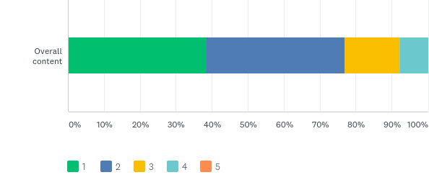
Q4: Please tell us whether you were satisfied with the overall content of the meeting. Use the following scale where 1 represents excellent and 5 represents unacceptable
Answered: 26 Skipped: 0
4 respondents made additional comments
Not enough law-focused.
A comprehensive programme and relevant issues addressed for all relevant group categories
The content of the programme could and should have been set out different. Any training on law should preferably start with an explanation of some legal jargon used. Whilst I am aware that different countries have different judicial systems, there are however some basic common concepts. Secondly, it is important that the idea behind every session is laid out. There were different activists and lobbyists whose work, in my opinion, is not directly related to the criminalisation of HIV transmission. Thirdly, at several points it was not clear whether we were talking about criminalisation of HIV transmission or exposure. The two are very different, deserving separate discussions - they attract different legal arguments.
It was very interesting meeting and quality of information was very high.

Slide 4
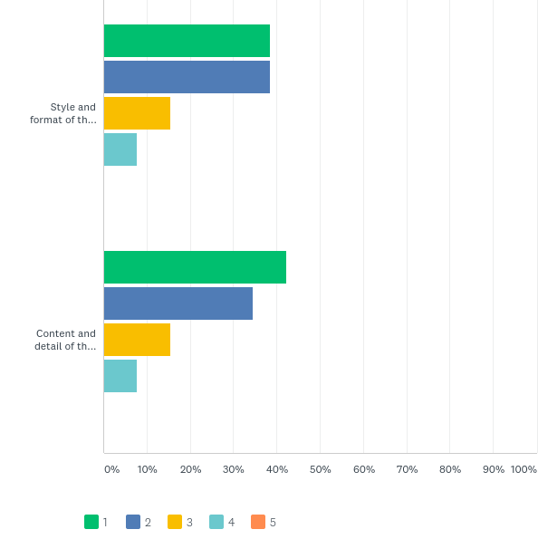
Q5: Please provide overall feedback from your experience of the sessions. Use the following scale where 1 represents excellent and 5 represents unacceptable
Answered: 26 Skipped: 0
One additional comment was made:
The sessions were very interactive, easy to understand and highlighted relevant and useful issues

Slide 5
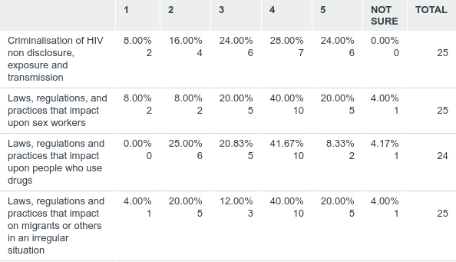
Q6: To what extent did the meeting increase your level of knowledge about .. .Please use the following scale where 1 represents very little and 5 represents a great deal.
Answered: 25 Skipped: 1

Slide 6
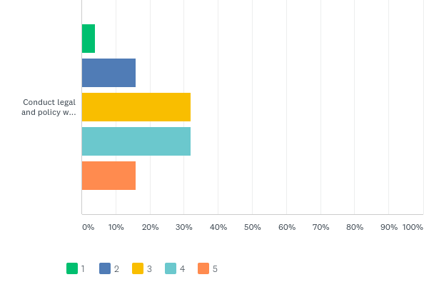
Q7: To what extent did the meeting give you any additional skills to conduct legal and policy work in relation to the issues Please use the following scale where 1 represents very little and 5 represents a great deal .
Answered: 25 Skipped: 1

Slide 7
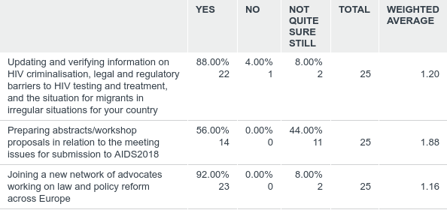
Q8: We asked you in advance of the meeting whether you or your organisation would be willing and able to be involved in any of the following activities. The purpose of this question is to confirm your level of interest after the meeting. Would you or your organisation be willing to do any of the following activities:
Answered: 25 Skipped: 1

Slide 8
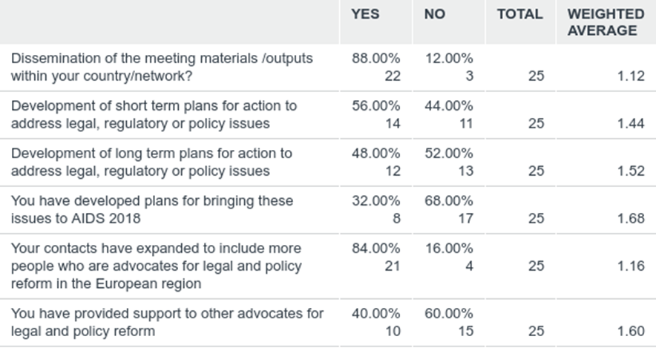
Q9: As a result of the meeting have any of the following happened ...
Answered: 25 Skipped: 1

Slide 9
Some suggestions for improvement
'The meeting was a great opportunity to meet other activists and discuss / learn more aout HIV criminalisation / criminalisation of sex work - drug use. However, i feel that each issue would really need to have their own meetings as some workshops were too broad (e.g: messaging workshop) and it felt representatives of key populations had to compete to put their issue on the table. There are lots of intersection between each issues of course but possibly in the future having thematic meeting on sex work, drug users, migrants etc would be useful. On the other hands, several young activists from STEP UP were very grateful of the presence of sex workers for example and said they learned a lot about the issues.
I would appreciate much more focus on discrimination of HIV positive patients by physicians and other healthcare professionals and on legal and other barriers to accessing healthcare other than testing and treatment of HIV itself (such as legal barriers to and/or discrimination in access to dentists, complicated surgeries or even general practitioners refusing to treat HIV positive patients etc.).
As a concept, the academy is a brilliant move. In my opinion, there does, however, need to be a greater involvement of lawyers, solicitors and ethicists. We have all heard the activist argument, over and over again. If we really want to scale up our work and our success rate, we need to engage people who have a background in law. Whilst in some cases, policy makers listen to activists, when it comes to criminal law, you have to, most of the time, use legal and ethical arguments.
The training was beneficial. However, as the candidates came from very diverse backgrounds and organisations, there were some challenges with the academy being a focused learning experience.
More days and more interesting training's on different aspects of living with HIV, Hepatitis, drug use. I am very interest in training on International Law, Strasbourg court, Experience of the International NGO's.

Slide 10
Additional Comments …
The training provided me with great information, practical knowledge and motivation to address the various barriers migrants face in accessing HIV testing and treatment etc.
I have studied the HIV justice toolkit, the barring access and criminalisation websites and now have a better grasp of the the legal frameworks and planning of advocacy in these areas.
We are planning to run country project to combat stigma and discrimination facts in Georgia and we will need help and support of international organisations.
I got a better overview of the situation in other European countries
First of all I start reading our regulations and law on HIV. Second The National drug policy platform advocates for huge changes in Georgian Criminal law on drugs. We are working on minimal doses of all street drugs and many other issues. I have many interesting news and I can report all in one or two presentations.
It was a great training and we would like to continue our involvement. The M-Care programme that AAF and EATG will deliver next year will greatly benefit from the resources and learning from this programme and experience of trainers
Thank you so much for this opportunity to participate, I would love to have this kind of workshop in Bucharest/Romania

